Slide 1

Lovekesh Bansal
Aparna Aidith
Abraham George
Hani Noueilaty

Slide 2
Background
Crowdfunding service
Huge number of categories
Founded in 2019
$4,045,755,730 pledged to creative projects
15,591,677 people have backed a Kickstarter project
300,000+ part-time and full-time jobs created by Kickstarter projects
Backers get rewards according to donations
Posts include images, topic, caption
Posts can be liked and shared over social media

Slide 3
Motivation
Dozens of projects are posted every day on Kickstarter. However, not all projects are created equally. We thought it would be interesting to understand:
What factors influence the success of Kickstarter projects?
What can cause projects failing to meet their funding goal?
What type of projects are more likely to succeed?
What type of projects are more likely to fail?
Would it be possible to somehow predict the likelihood of a Kickstarter project succeeding or failing solely based on the project’s data?

Slide 4
Data
Found a scraper bot that scrapes Kickstarter on monthly basis and stores data
Scraping is incremental in nature
Originally had 37 features. We reduced it to half and added more by dividing existing
the end we had 49 features after doing all feature engineering

Slide 5
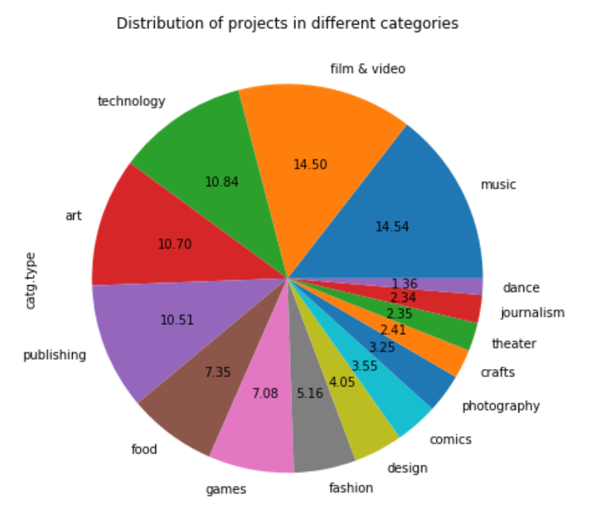
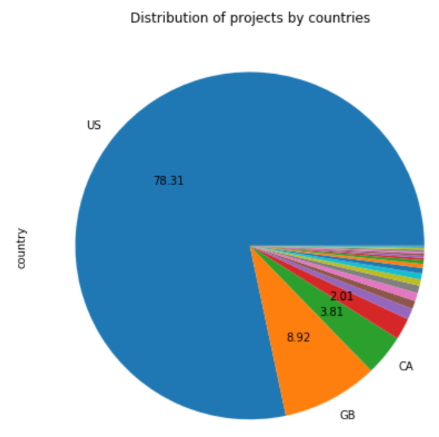
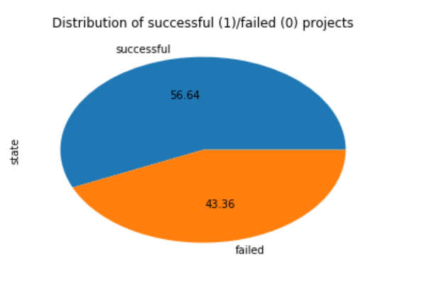
Data Analysis Pt. 1

Slide 6
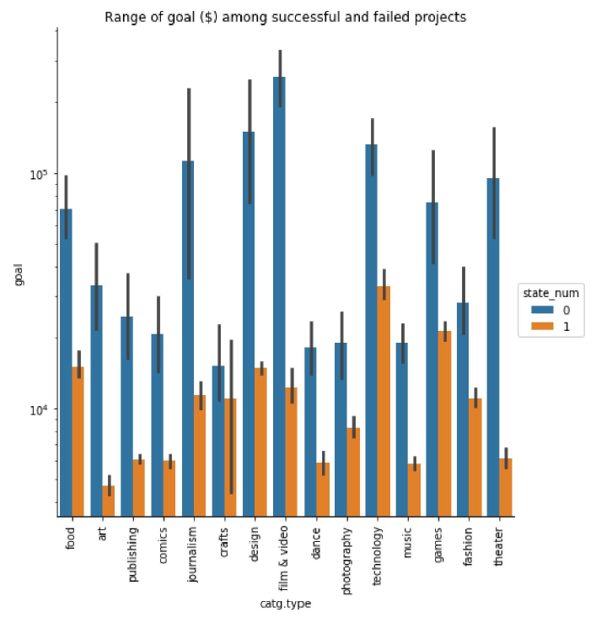
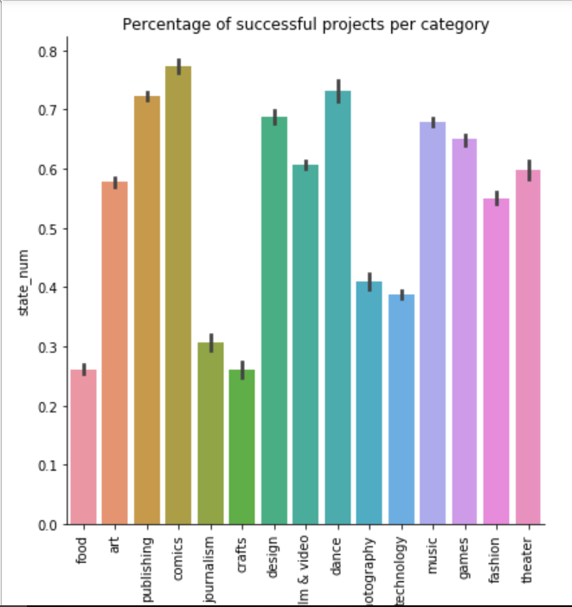
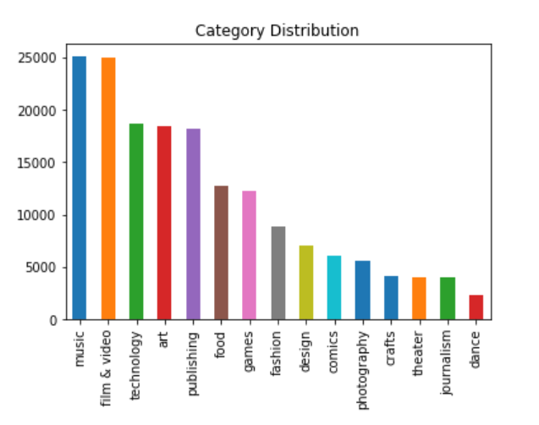
Data Analysis Pt. 2

Slide 7
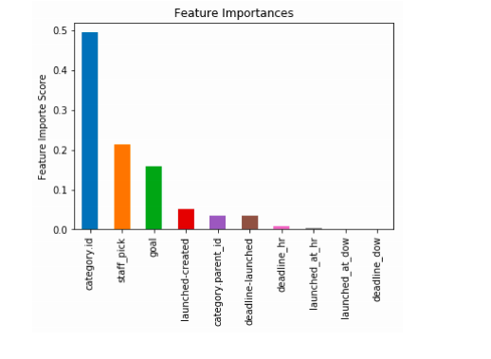
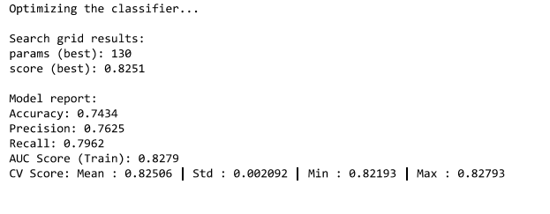
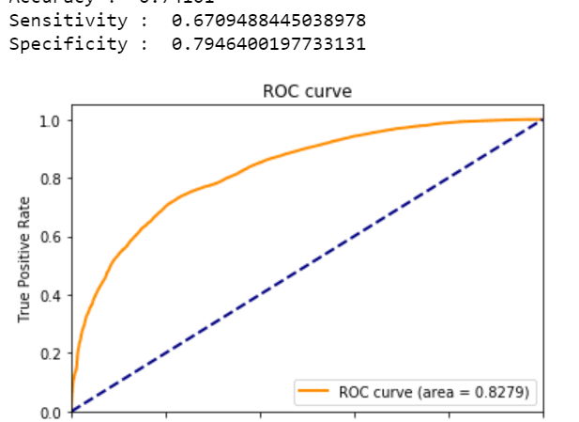
Results - Random forest

Slide 8
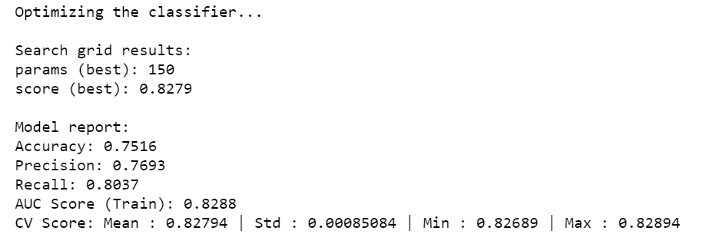
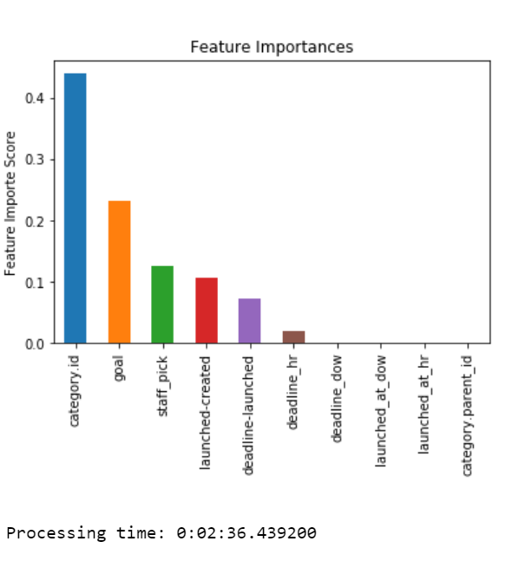
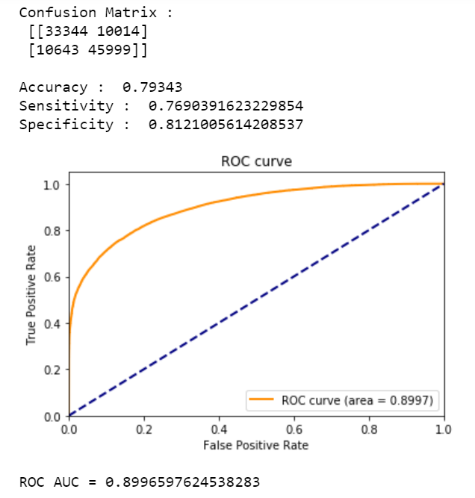
Gradient Boosting

Slide 9
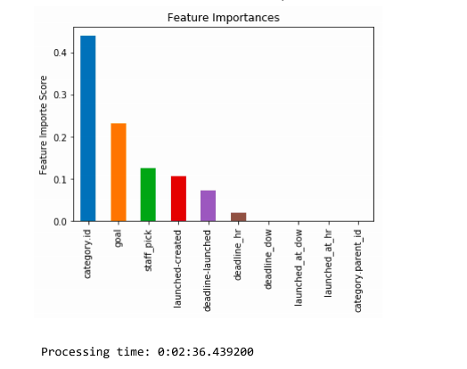
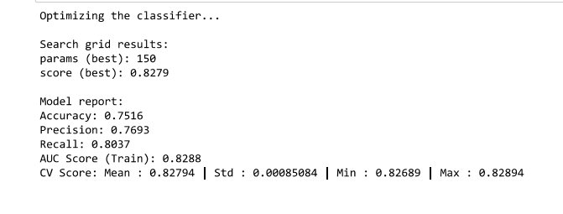
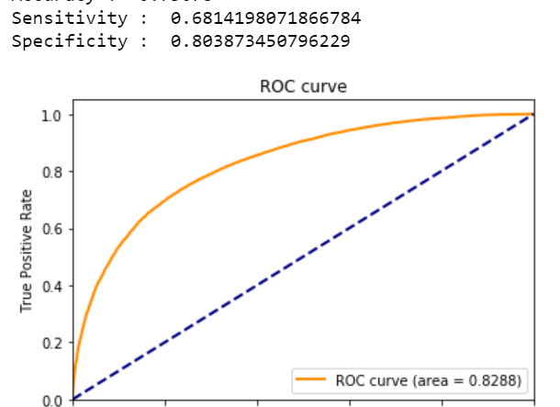
Adaptive Boosting

Slide 10
Key Takeaways
Setting up cloud instances to run neural networks
Feature Selection
Exploring Google Dataset search service
Exploring web robots
Arts and tech have higher success rate
US based projects have better success rate

Slide 11
Q&A

